Slide 1
Gravitational Waves: Experimental Techniques
2
Gabriele Vajente
LIGO Laboratory – California Institute of Technology
TRISEP 2018 - Perimeter Institute

Slide 2
Outline
Lecture 1: the basics of interferometric detection of gravitational waves
Lecture 2: fundamental noise sources (seismic, thermal and quantum noises)
Lecture 3: the dirty reality of ”technical noises” (scattered light, control noise, etc…) and prospects for the future

Slide 3
Fundamental Noise sources
Lecture 2

Slide 4
Advanced LIGO design

Slide 5
Seismic (-related) noise

Slide 6
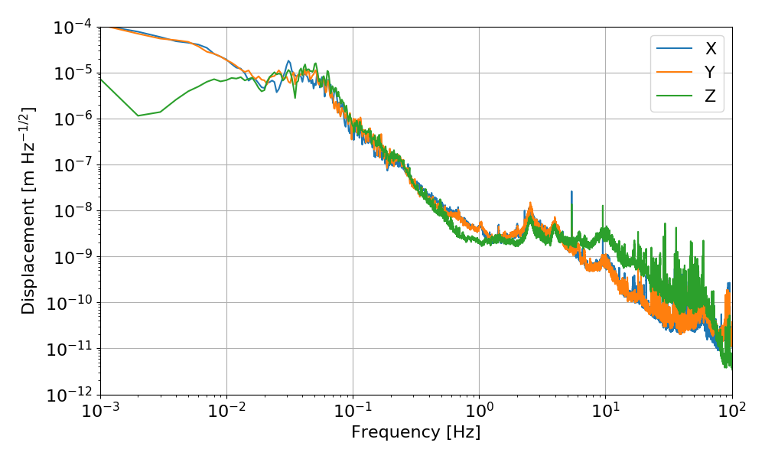
Seismic noise
Ground motion is way too large!
z
x
y

Slide 7
Passive isolation

Slide 8
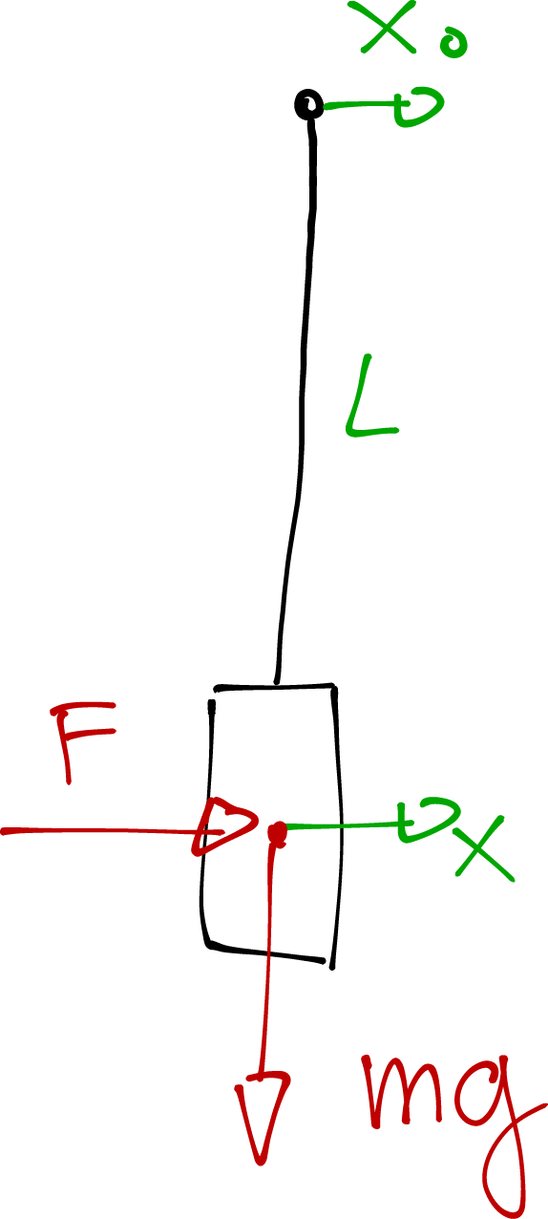
Passive isolation
L = 1 m
f₀ = 0.5 Hz

Slide 9
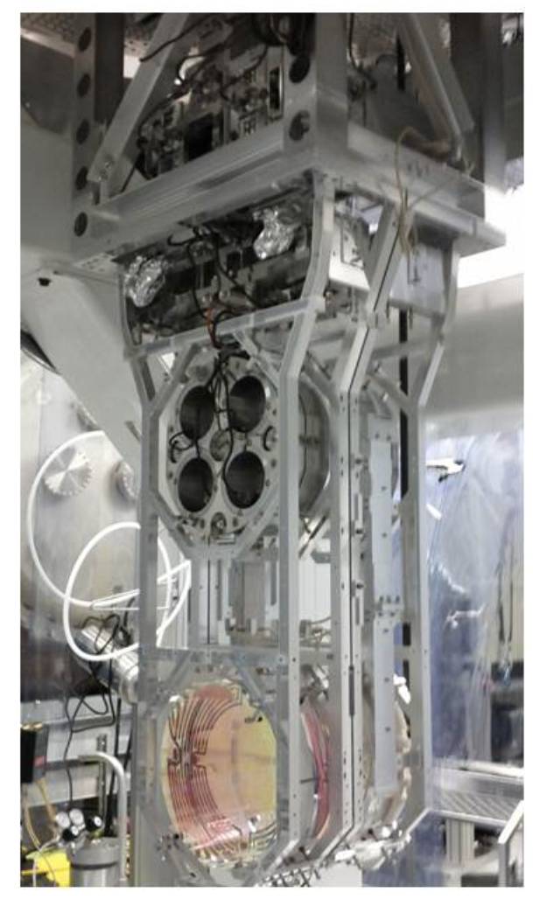
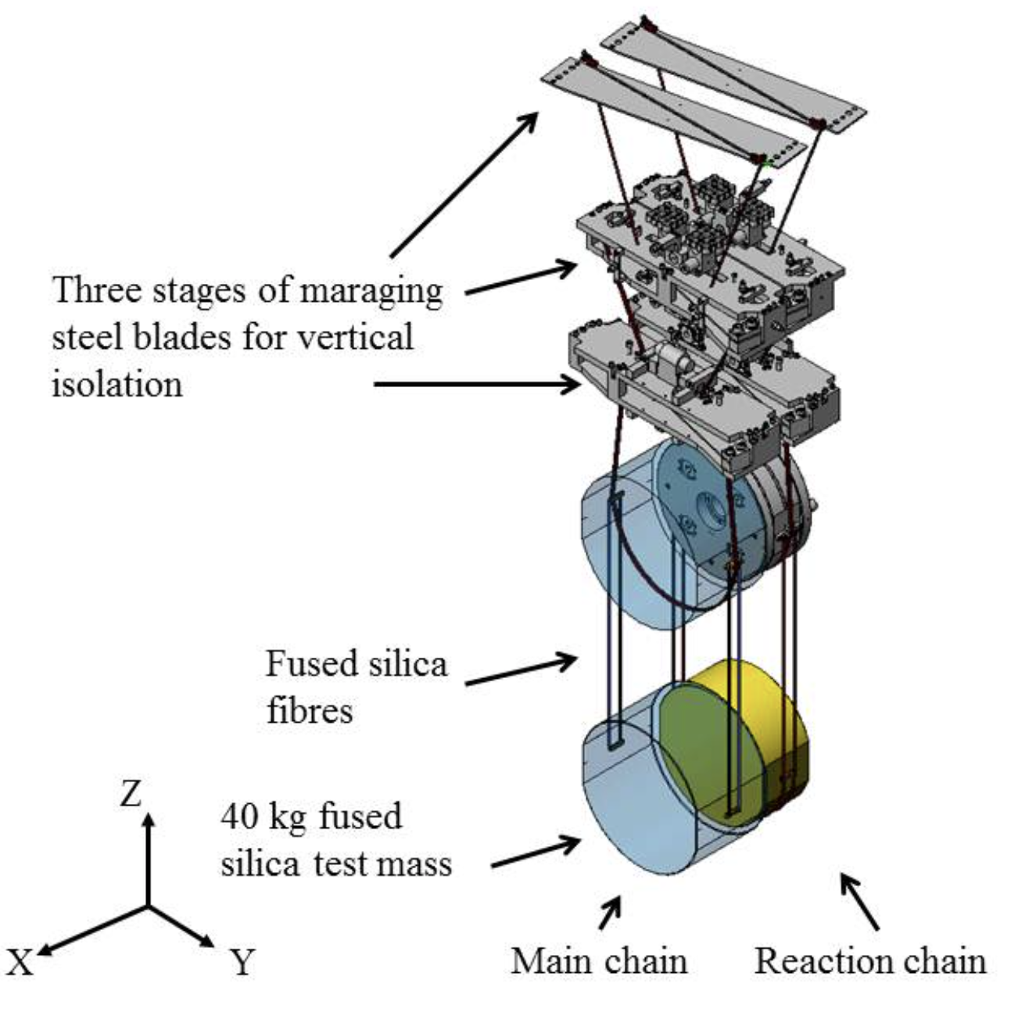
Advanced LIGO: quadruple suspension

Slide 10
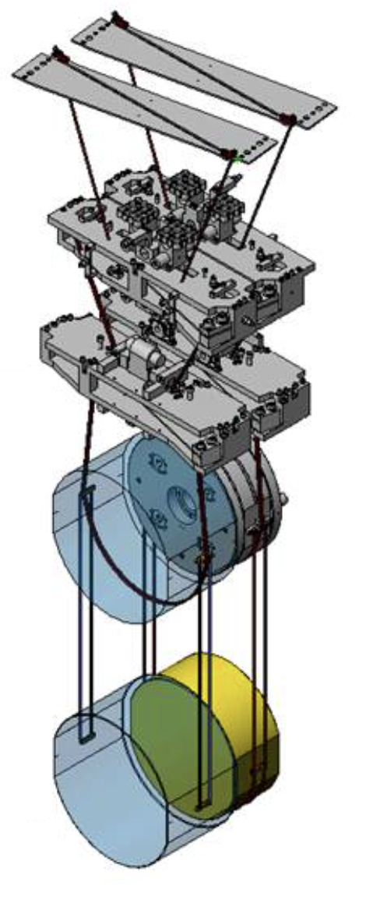
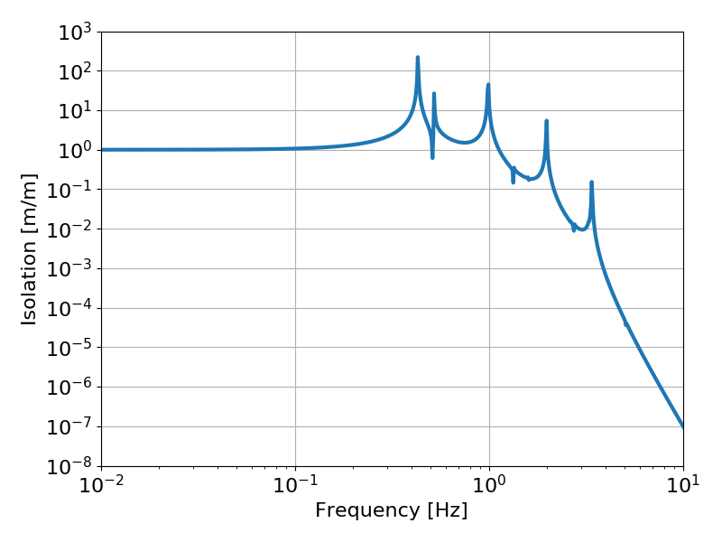
Advanced LIGO: quadruple suspension
S M Aston et al 2012 Class. Quantum Grav. 29 235004

Slide 11
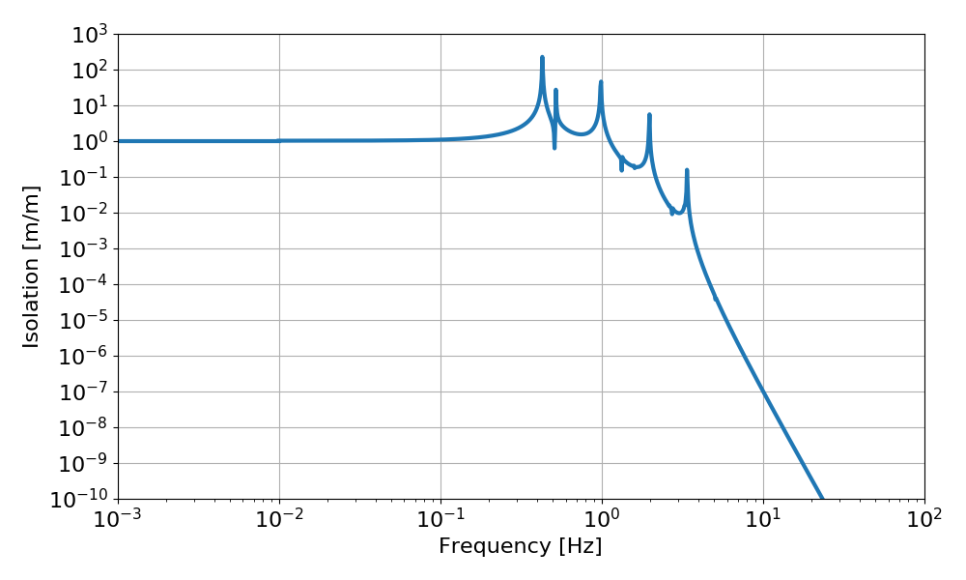
But…

Slide 12
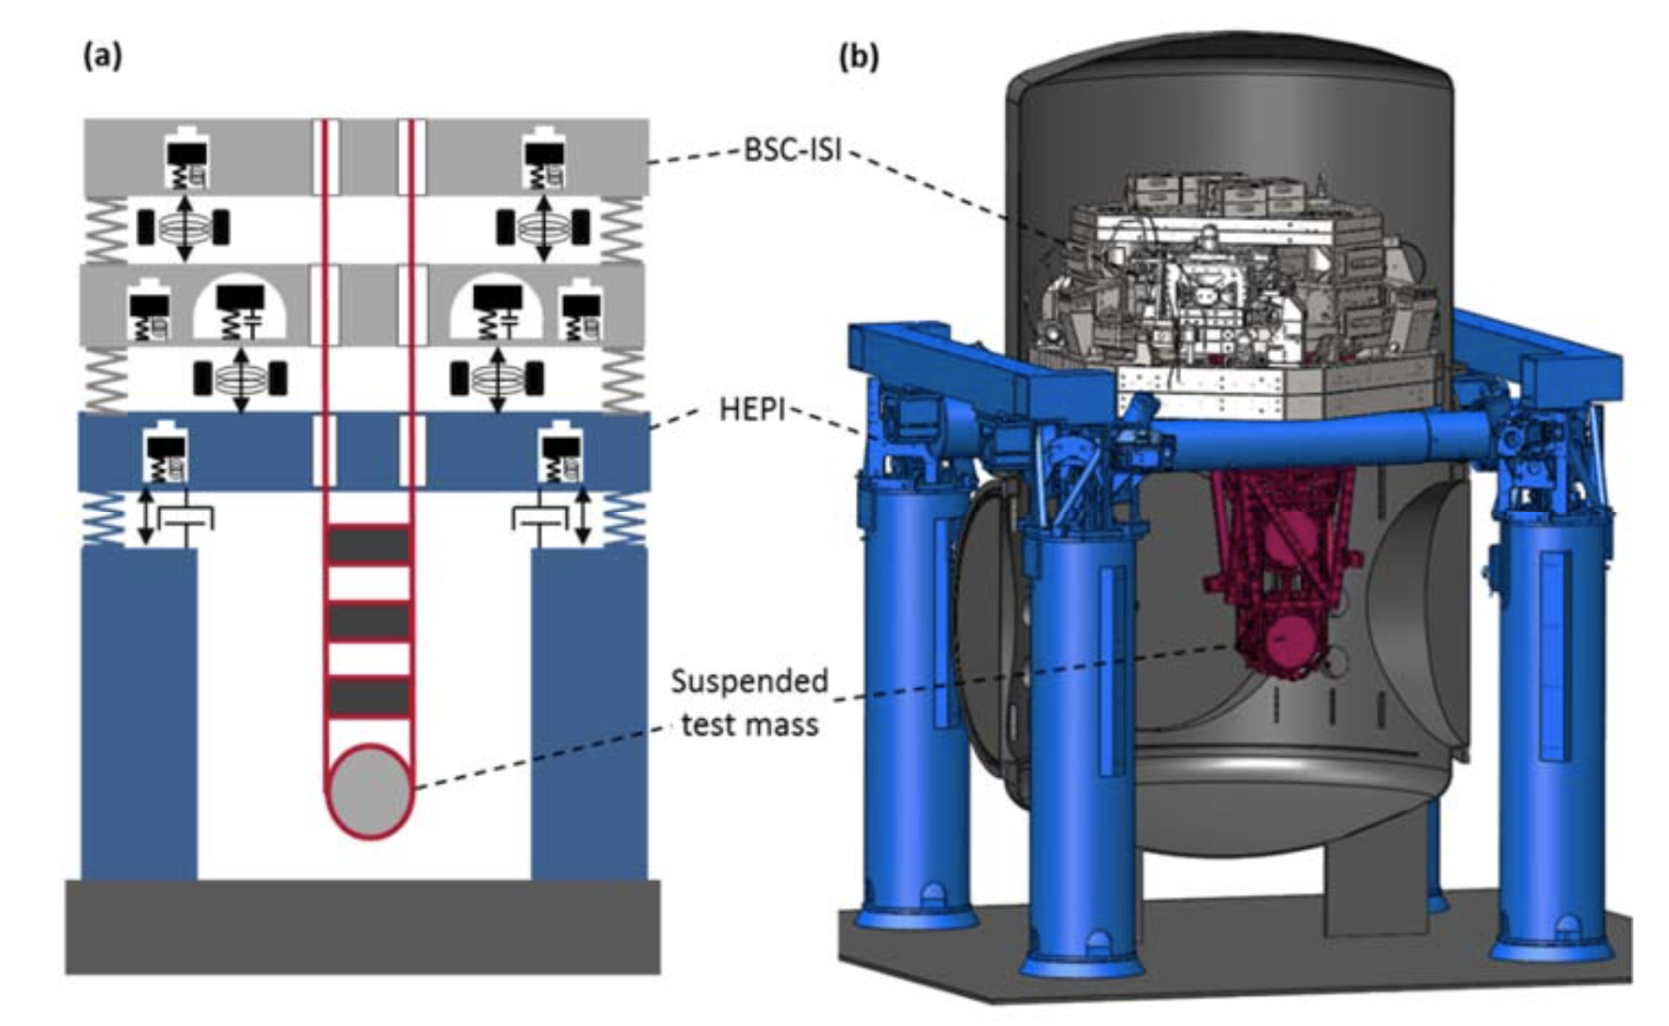
Active isolation
F Matichard et al 2015 Class. Quantum Grav. 32 185003

Slide 13
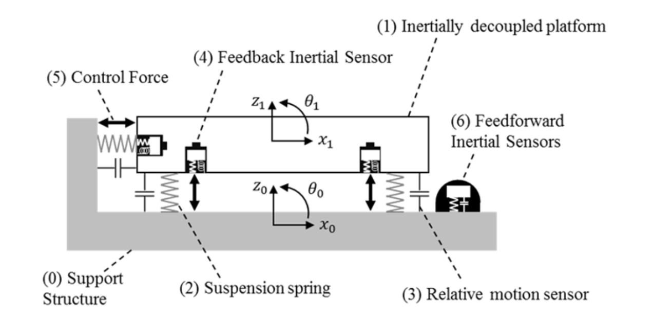
Active isolation
F Matichard et al 2015 Class. Quantum Grav. 32 185003

Slide 14
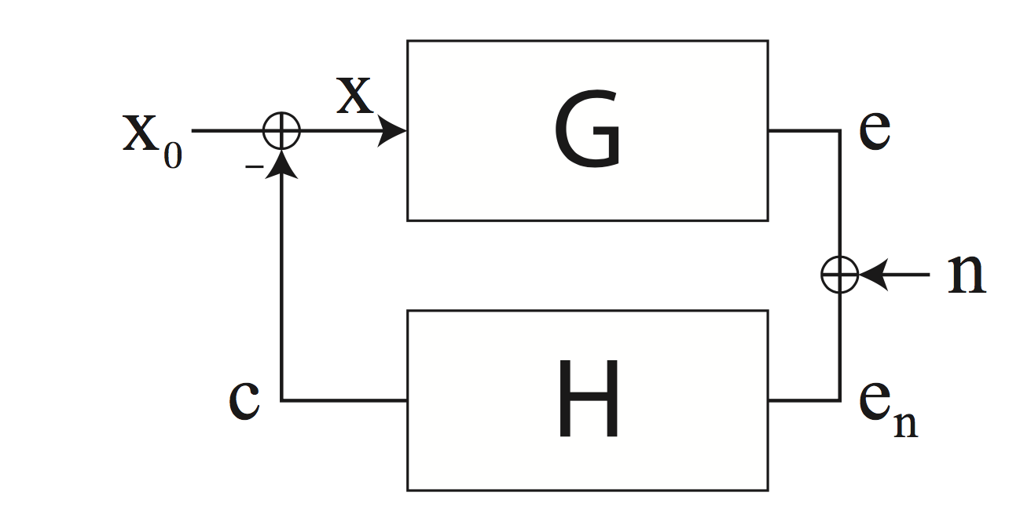
Control systems and sensor noise

Slide 15
Control systems and sensor noise

Slide 16
Active isolation
F Matichard et al 2015 Class. Quantum Grav. 32 185003

Slide 17
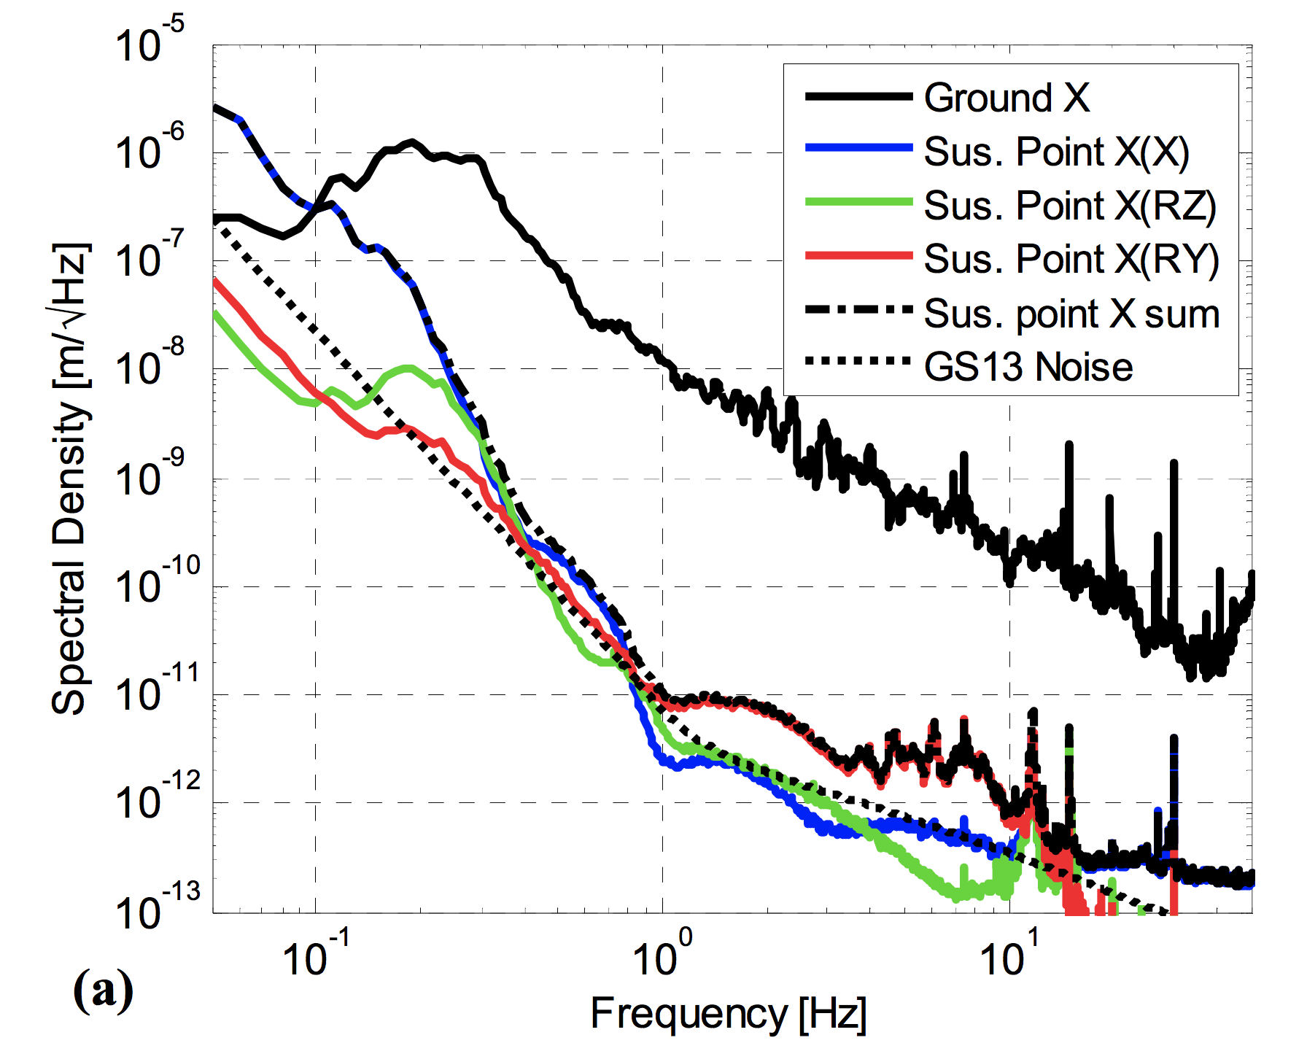
Active isolation

Slide 18
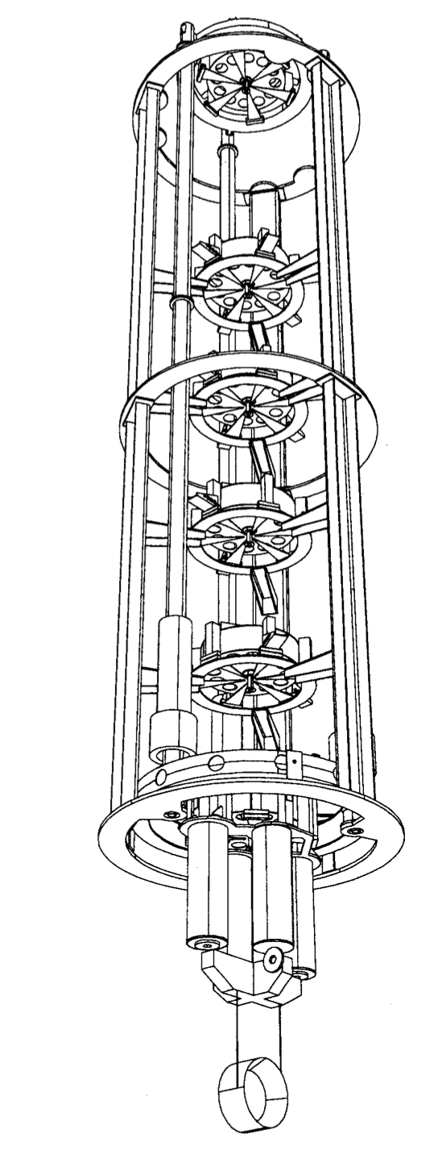
Advanced Virgo: Superattenuator

Slide 19
Inverted pendulum

Slide 20
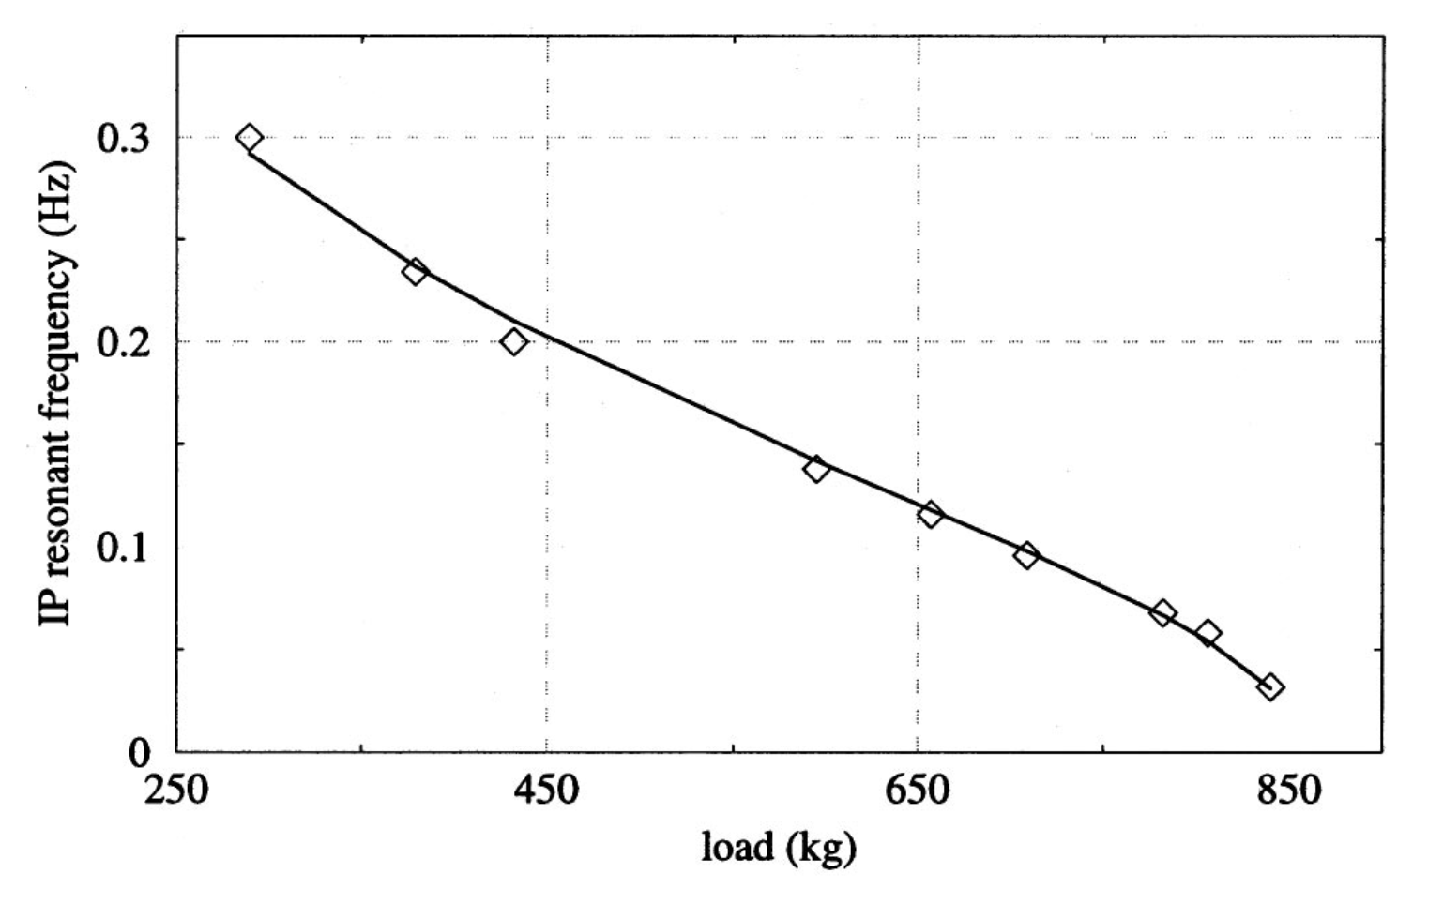
Inverted pendulum
Review of Scientific Instruments 70, 2507 (1999); doi: 10.1063/1.1149783

Slide 21
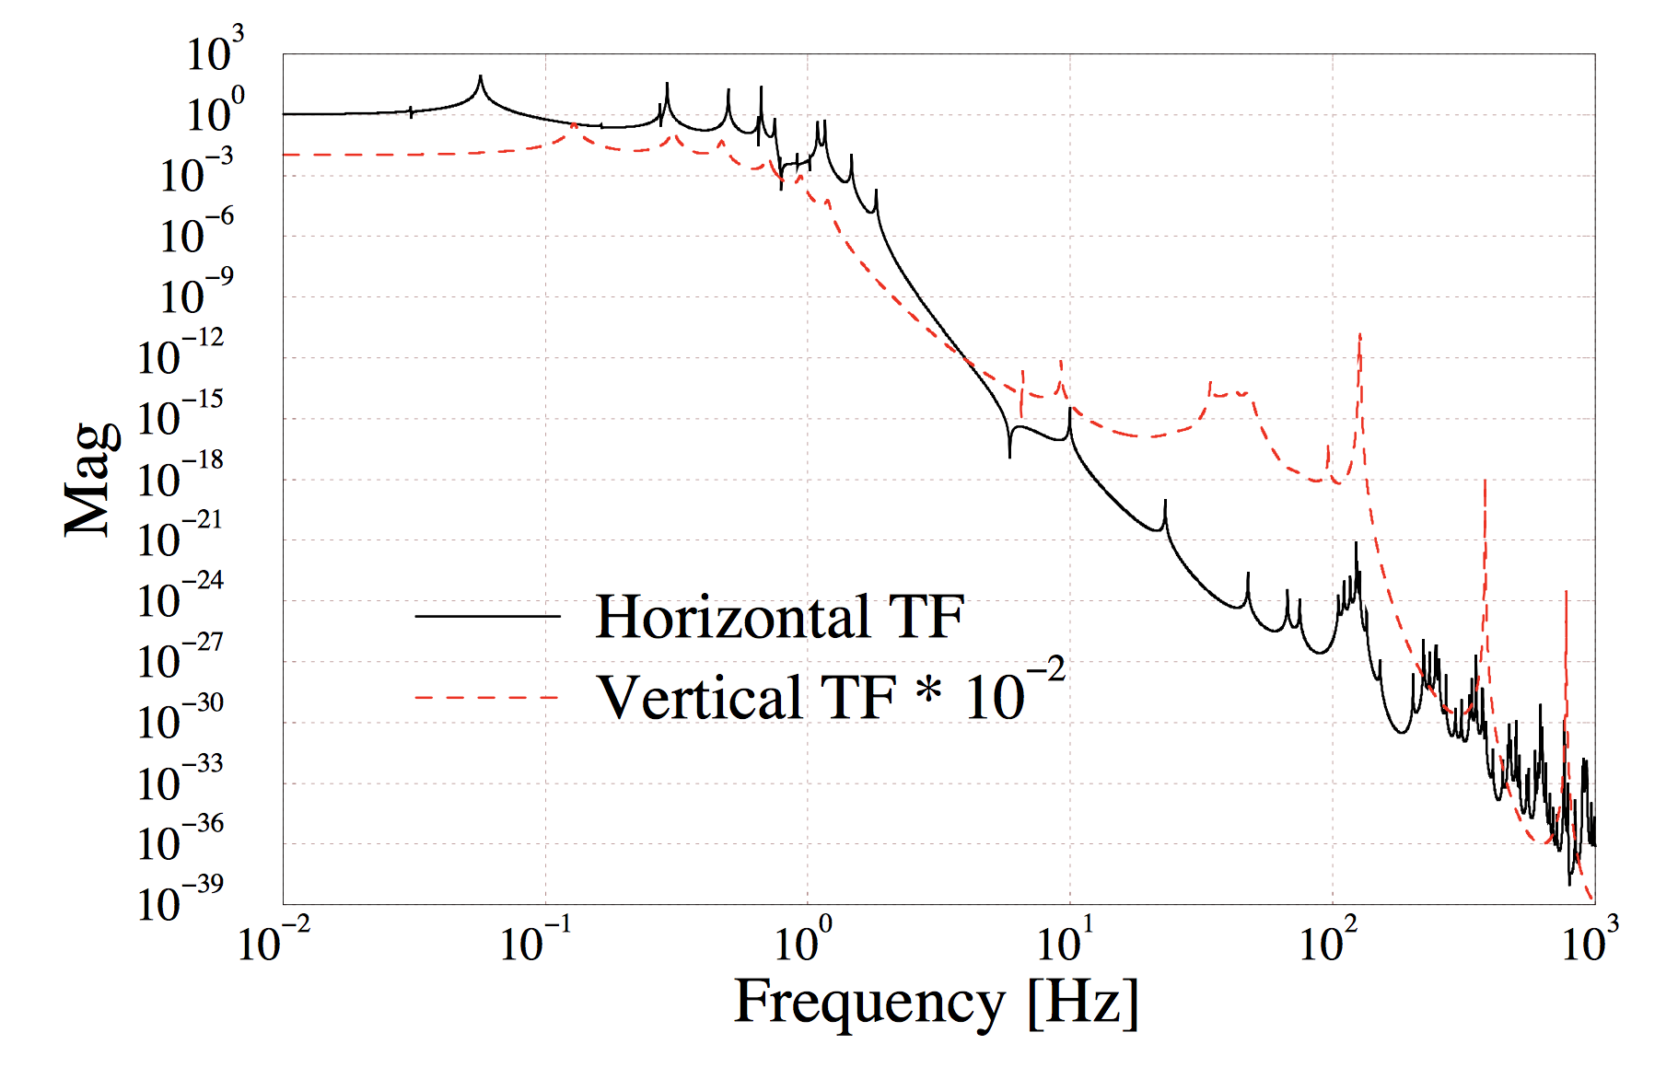
Advanced Virgo: Superattenuator
Review of Scientific Instruments 72, 3643 (2001); doi: 10.1063/1.1392338

Slide 22
Newtonian noise

Slide 23
Newtonian noise

Slide 24
Thermal noise

Slide 25
Thermal noise
All physical objects are in thermal contact with the environment: thermal equilibrium
Two aspect of the same microscopic physics:
Friction: the system loses energy that goes into heat dissipated to the environment
Thermal noise: the environment couples back energy into the system

Slide 26
Friction

Slide 27
Friction

Slide 28
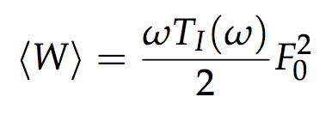
Friction
Work done by the external force:

Slide 29
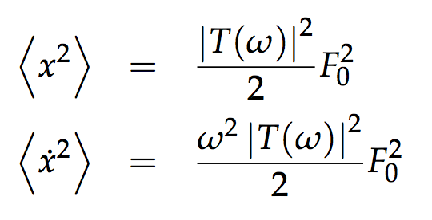
Friction
Work done by the external force:

Slide 30
Thermal motion
Langevin’s equation

Slide 31
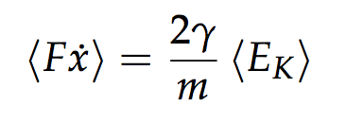
Thermal motion
Langevin’s equation

Slide 32
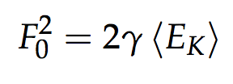
Thermal motion
Langevin’s equation (for a simple harmonic oscillator)

Slide 33
Thermal motion
Langevin’s equation

Slide 34
Thermal noise in a pendulum

Slide 35
Fluctuation dissipation theorem

Slide 36
Fluctuation dissipation theorem
Thermodynamics
Displacement noise
of the suspended mass
Mechanics: response of the system to external disturbance

Slide 37
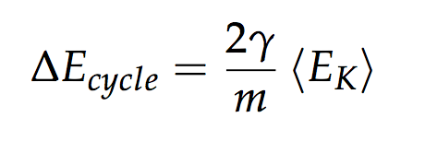
Structural damping
Viscous damping:

Slide 38
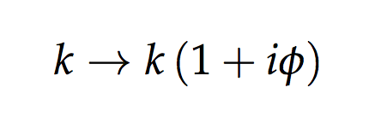
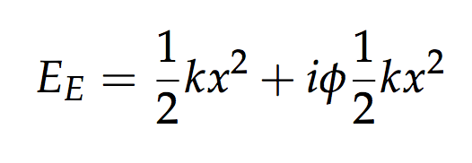
Structural damping
Viscous damping:

Slide 39
Structural damping

Slide 40
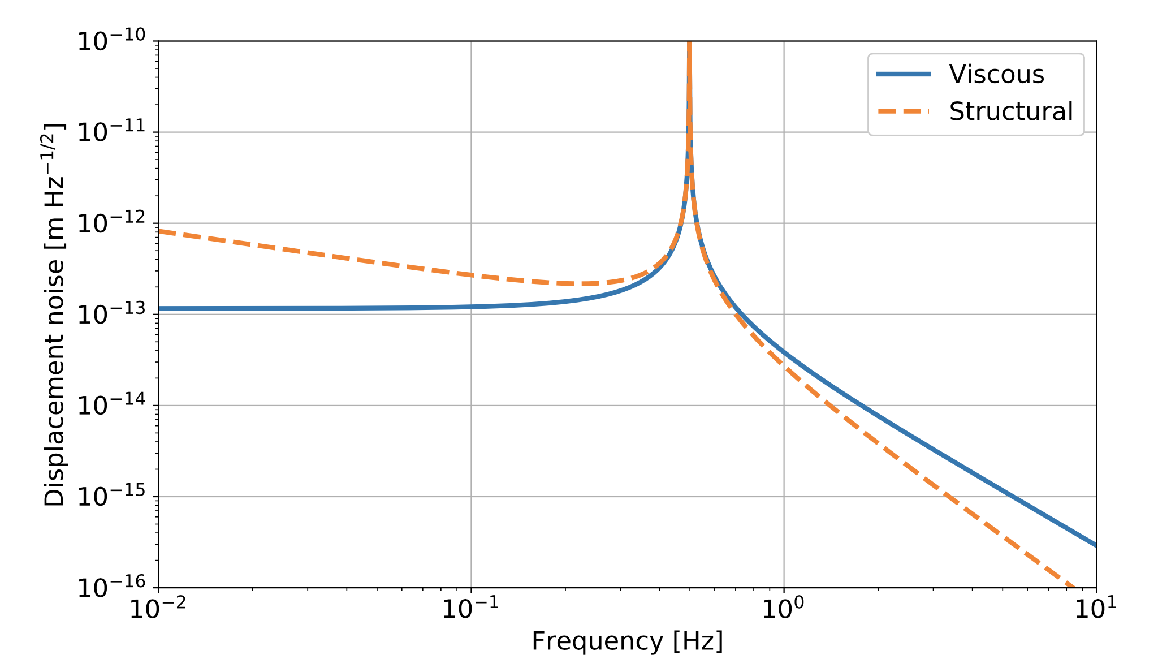
Structural vs Viscous

Slide 41
Sources of thermal noise

Slide 42
Sources of thermal noise

Slide 43
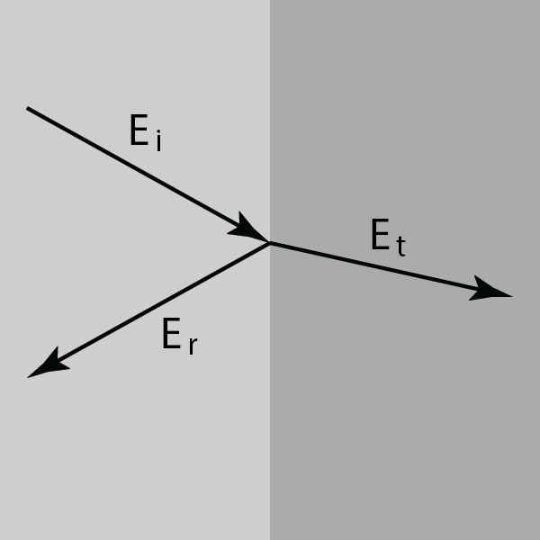
Coatings
Fresnel reflection

Slide 44
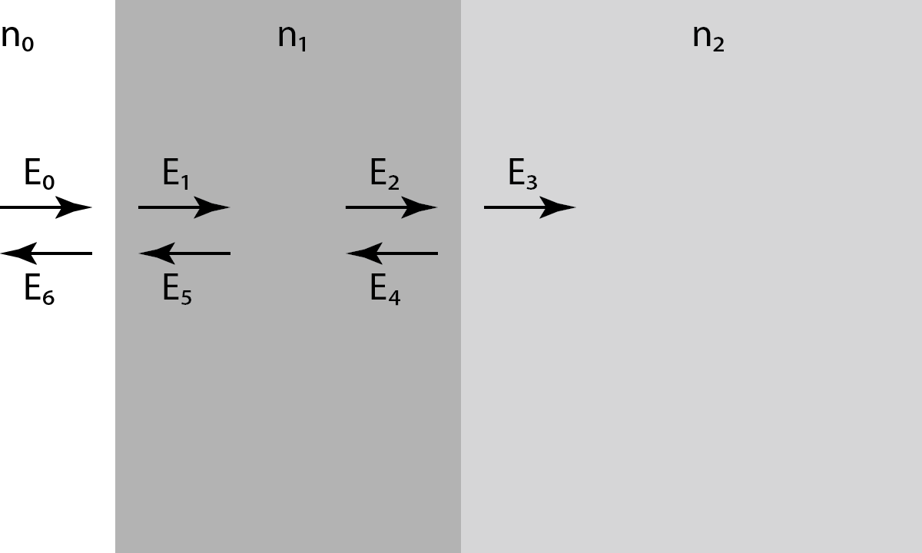
Coatings
Fresnel reflection

Slide 45
Coatings
Fresnel reflection

Slide 46
Coatings

Slide 47
Multi layer coatings
Interference of Fresnel reflections
Material | Refractive index | Loss angle
Silica SiO₂ | 1.45 | 0.4 x 10⁻⁴
Tantala Ta₂O₅ | 2.03 | 3.4 x 10⁻⁴
Titania-doped tantala Ta₂O₅-TiO₂ | 2.07 | 2.3 x 10⁻⁴
Silica
Titania-doped-Tantala*
Silica
Titania-doped-Tantala*
Silica
Titania-doped-Tantala*
Substrate

Slide 48
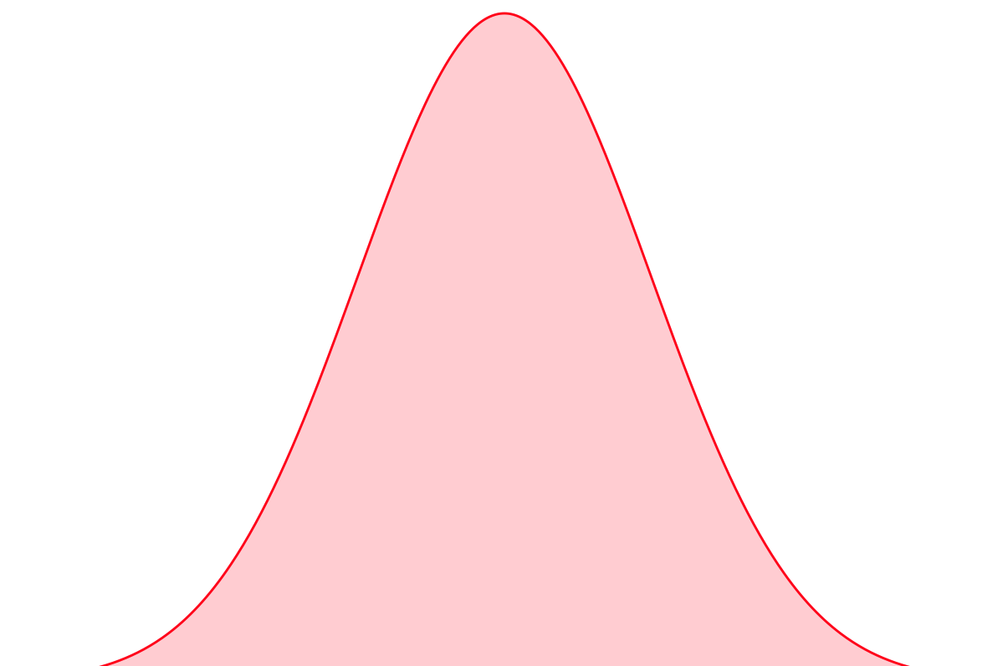
Thermal noise in coatings
We measure the surface motion of the mirror, monitoring the phase of the reflected beam
We average over a large surface, determined by the beam Gaussian distribution (radius ~5-6 cm)
The phase changes due to
Surface displacement (Brownian noise)
Change in the material and layer properties: thermal expansion, change of refractive index with temperature (Thermo-optic noise)

Slide 50
Coatings Brownian noise
Silica
Titania-doped-Tantala*
Silica
Titania-doped-Tantala*
Silica
Titania-doped-Tantala*
Substrate

Slide 51
Quantum noise

Slide 52
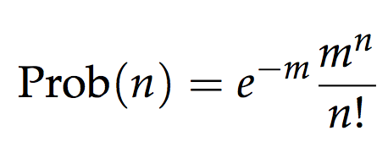
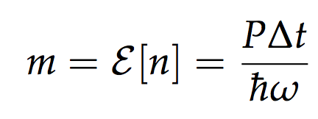
Shot noise again
Quantum nature of light: photons
Measuring power = measuring the number of photons
Poisson statistics
This is simplified description, useful only in very simple cases
What is a good quantum description?

Slide 53
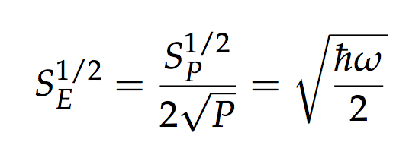
Shot noise again
Quantum nature of light: photons
Measuring power = measuring the number of photons
Poisson statistics
This is simplified description, useful only in very simple cases
What is a good quantum description?

Slide 54
Radiation pressure
Photons carry momentum: a laser beam exerts a force on a mirror

Slide 55
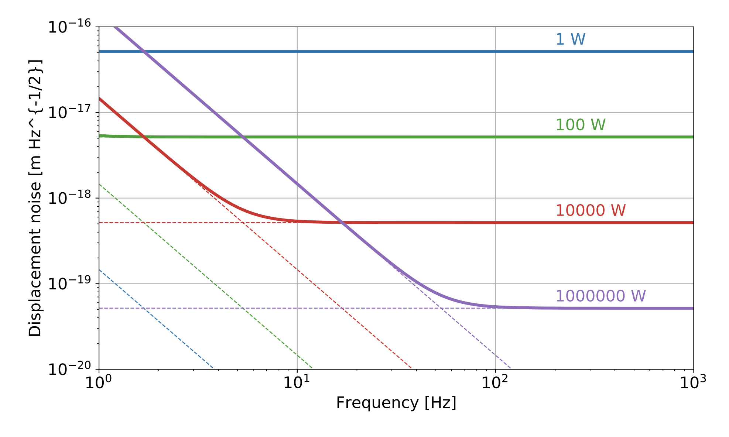
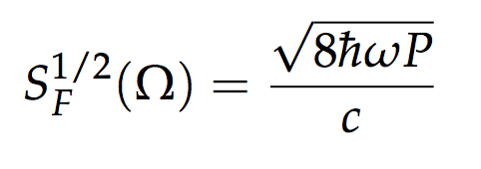
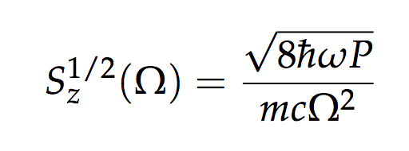
Radiation pressure
Photons carry momentum: a laser beam exerts a force on a mirror

Slide 56
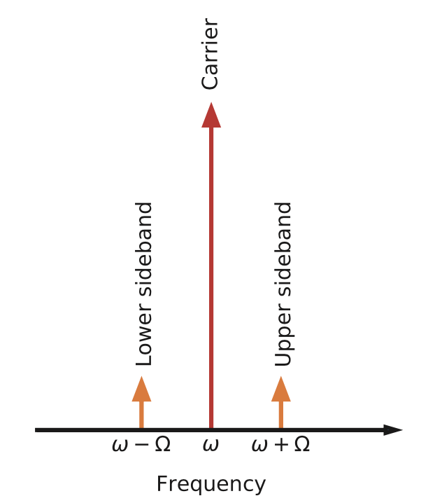
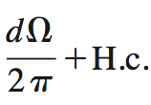
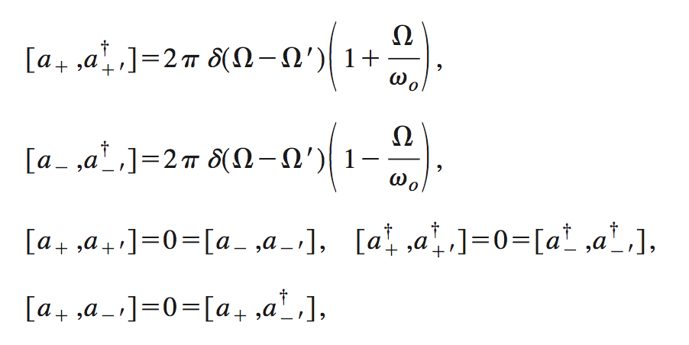
Quantum description
Electromagnetic field in the Heisenberg picture
PHYSICAL REVIEW D, VOLUME 64, 042006

Slide 57
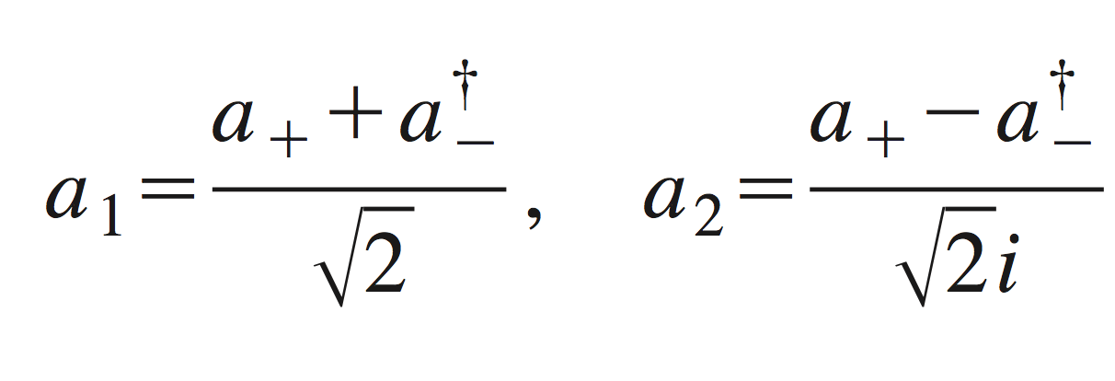
Quantum description
Electromagnetic field in the Heisenberg picture
PHYSICAL REVIEW D, VOLUME 64, 042006

Slide 58
Quantum description
Quantum:
Classical:
Quantum:
Classical:

Slide 59
Quantum Description
Commutation relations
We can treat the two quadrature as classical variable when propagating them
But when we measure them (simultaneously, using a photodiode) we need to take into account the quantum commutation relations > Heisenberg uncertainty > quantum noise

Slide 60
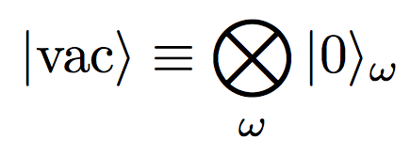
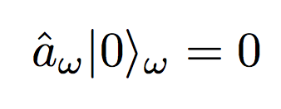
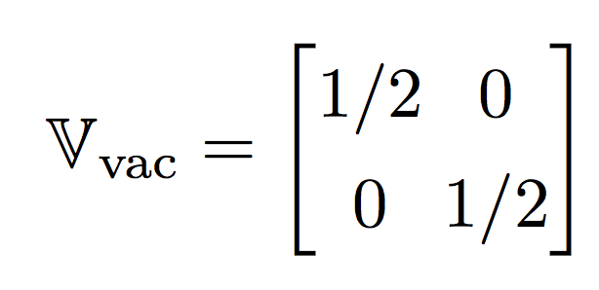
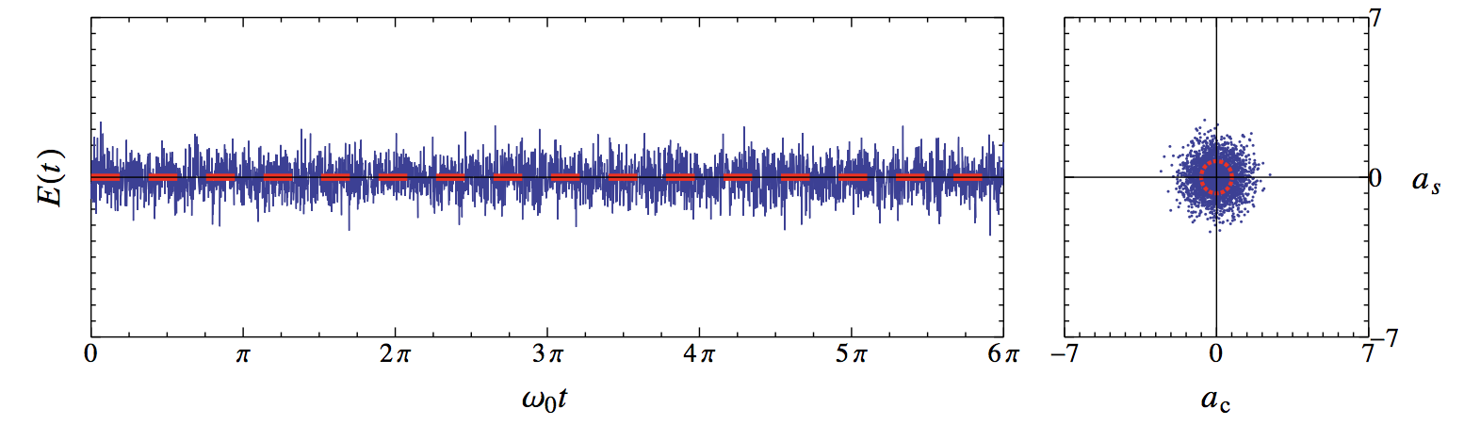
Quantum states
Vacuum state:
Time domain representation of the electric field measurement:
Living Rev. Relativity, 15, (2012), 5

Slide 61
Quantum states
Coherent states: that’s what a laser would produce

Slide 62
How vacuum enters in the interferometer

Slide 63
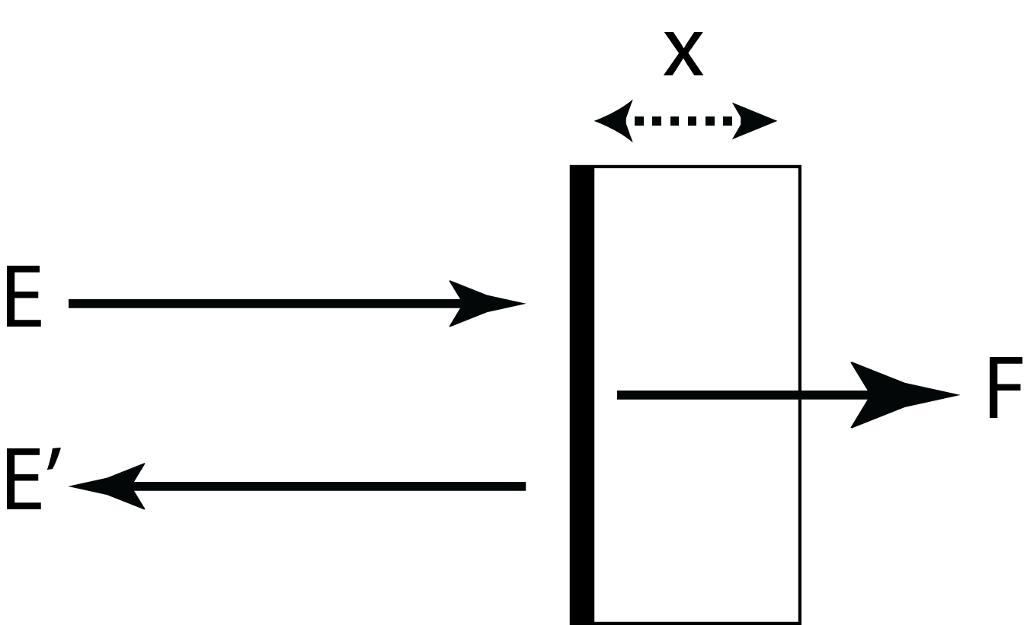
Radiation pressure induces correlations

Slide 64
Radiation pressure induces correlations

Slide 65
Phase rotation

Slide 66
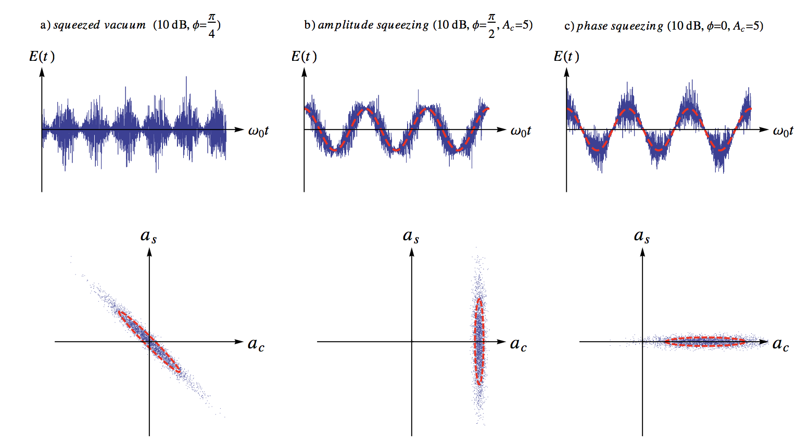
Squeezed states

Slide 67
Squeezed vacuum for an interferometer

Slide 68
How to generate squeezed states

Slide 69
How to generate squeezed states
arXiv:1206.2527 [quant-ph]

Slide 70
How to generate squeezed states
arXiv:1206.2527 [quant-ph]

Slide 71
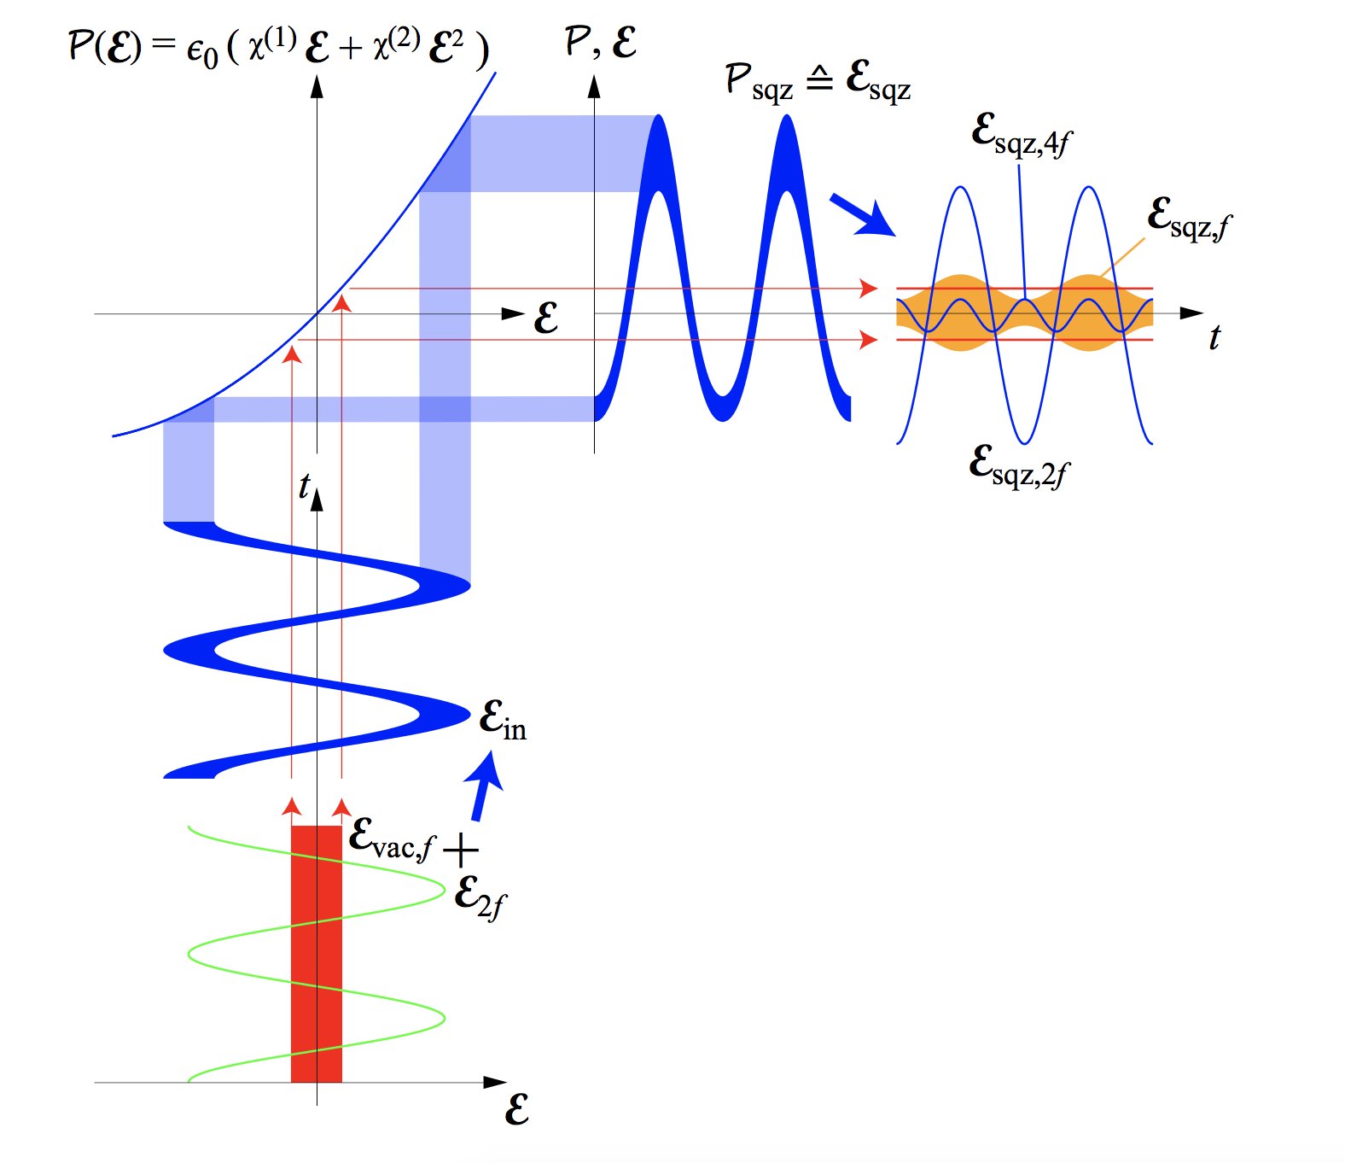
Non linear Optical Parametric Amplifier
arXiv:1206.2527v3 [quant-ph]

Slide 72
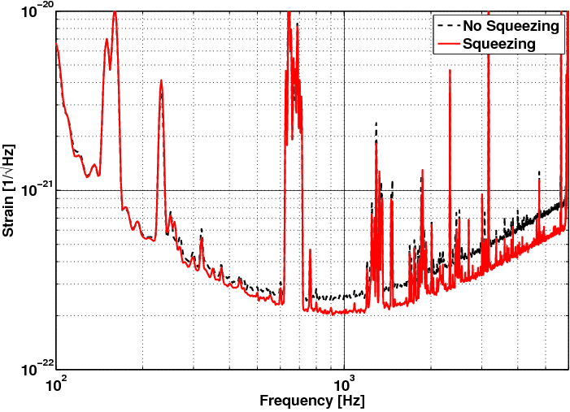
Squeezing for real: GEO 600
Phys.Rev.Lett. 110 (2013) no.18, 181101

Slide 73
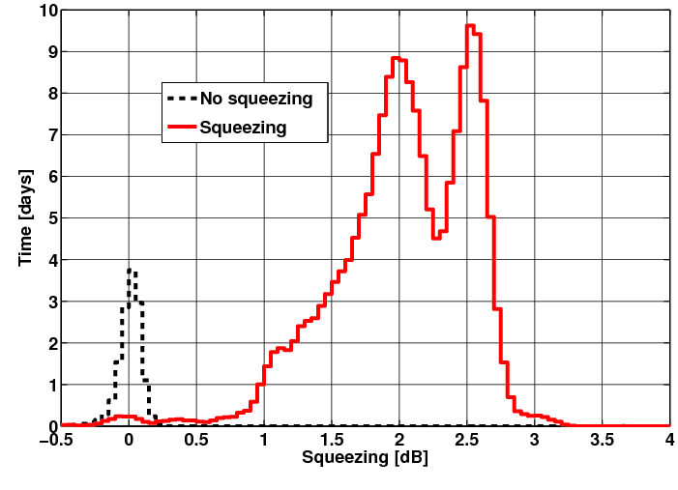
Squeezing for real: GEO 600
Phys.Rev.Lett. 110 (2013) no.18, 181101

Slide 74
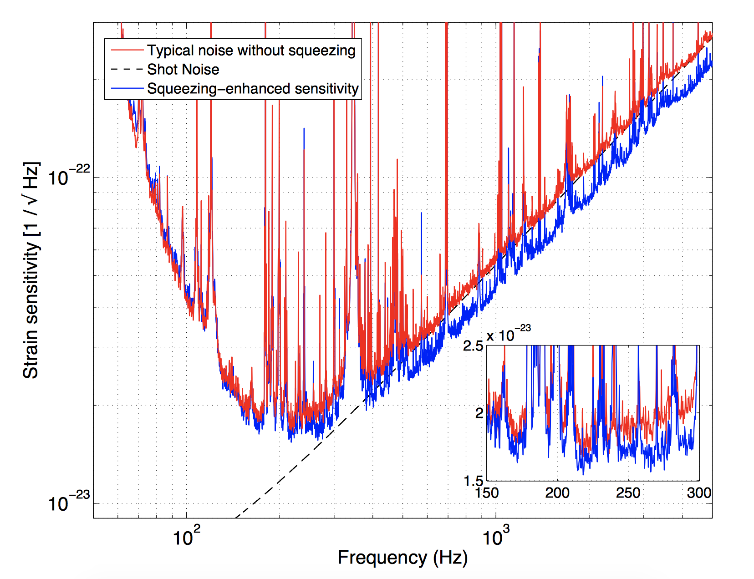
Squeezing for real: eLIGO
Nature Photonics volume 7, pages 613–619 (2013)

Slide 75
Next time…
Gabriele Vajente
LIGO Laboratory California Institute of Technology
1200 E. California Blvd.
Pasadena (CA) 91125 – USA
vajente@caltech.edu

